Slide 1
Campus Network with VLAN & Inter-VLAN Routing
Nicholas Palceski, Daniel Lowry
COP 3635 — Systems and Networks
Dr. Deepa Devasenapathy

Slide 2
🔍Overview
Simulate University Campus Network using multiple VLANs connected via Inter-VLAN Routing
Seperated into 3 groups:
Students
Faculty
Administration
VLAN (Virutal Local Area Network) groups different computers into a network virtually, allowing the benefits of LAN without requiring physical proximity
Inter-VLAN Routing allows all the VLANs to communicate with one another

Slide 3
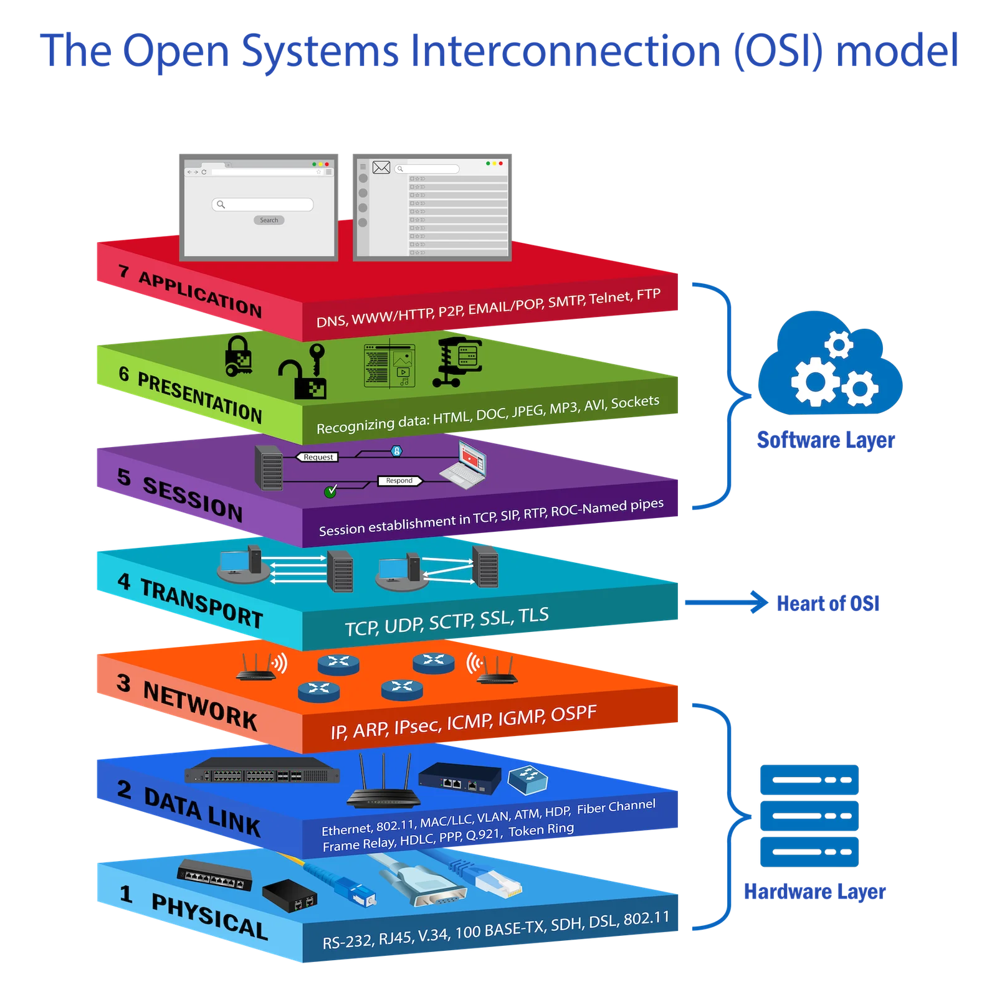
📊OSI Layers
Layer 1 (Physical) - Cables & ports used to form the network. Crucial for trunk links that connect switches to routers/other switches
Layer 2 (Data Link) - VLAN IEEE tagging (802.1Q), MAC address learning, and framing
Layer 3 (Network) - For Inter-VLAN Routing. Sends traffic to a Layer 3 device (router or switch), uses IP addressing to route packets between subnets

Slide 4
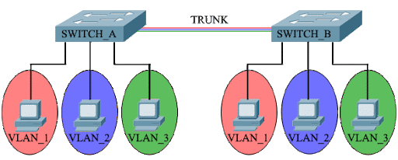
❓What is VLAN?
Logical, software-based segmentation of a physical network into distinct broadcast domains
Allows devices to be grouped together even if connected to different switches
Unlike LANs, VLANs can operate and function properly regardless of physical promixity to one another

Slide 5
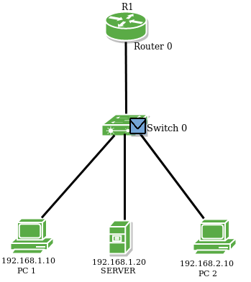
🖥️VLAN vs. Inter-VLAN Routing
Enables communication between different VLANs by using a Layer 3 device (router and switch) to route traffic between the different subnets/VLANs
2 primary methods: router-on-a-stick (ROS) & switched virtual interfaces (SVIs)
ROS - uses one physical router interface that is connected to a trunk port on a switch, using sub-interfaces for each VLAN
SVIs - created for each VLAN on a multilayer switch (connector switch) to act as the default gateway.

Slide 6
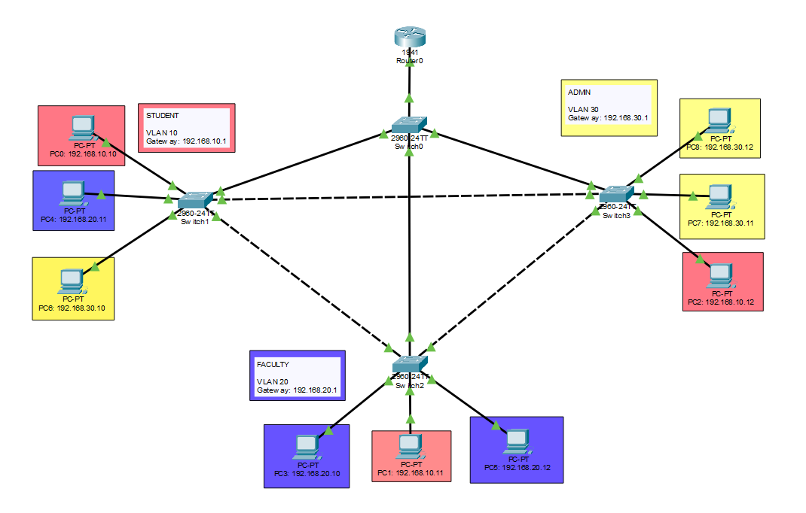
🌐Network Topology

Slide 7
🎬Live Demonstration
📝Test 1:
Ensure connection between PCs and Router.
🧪Test 2:
Sending packets from one VLAN to another using Inter-VLAN Routing.

Slide 8
🤝Contributions
Daniel Lowry:
VLAN & inter-VLAN research
Refining network topology
Testing network functionality
PowerPoint presentation construction
Refining Project Report
Nicholas Palceski
VLAN & inter-VLAN research
Network topology construction
Testing network functionality
Refining PowerPoint presentation
Project report Construction

Slide 9
📍Conclusion
VLANs and the communication between them play a crucial role in smaller networks as well as the wider Internet as whole
Improve security by isolating sensitive traffic (e.g., Guest VLANs) from main corporate data
Performance by reducing broadcast traffic impact
And are essential in Voice over IP (VoIP), isolates voice traffic to guarantee quality of service

